Slide 1

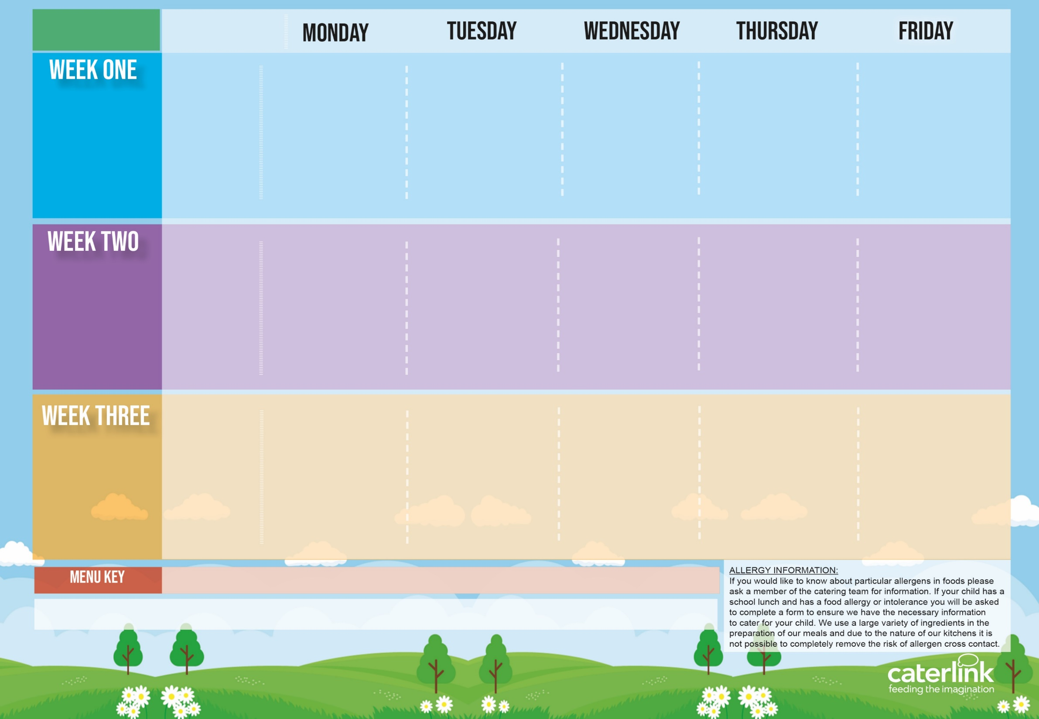






Autumn Winter
2025 2026
Option
One
Veggie Option
Vegetables
Dessert
Veggie Balls in Tomato Sauce with Rice | Beef Lasagne with Garlic Bread | Roast Chicken, Stuffing, Roast Potatoes and Gravy | Chicken Biryani | Fishfingers with Chips & Tomato Sauce
Autumn Vegetable Lasagne | Beetroot and Lentil Burger in a Bun with Potato Wedges | Vegetarian Wellington with Roast Potatoes and Gravy | BBQ Sausage Pasta with Garlic Bread | Cheese and Bean Pasty with Chips and Tomato Sauce
Sweetcorn and Peas | House Salad | Carrots & Broccoli | Green Beans | Garden Peas
Cheese and Crackers | Apple Crumb Cake | Fruit Medley | Jelly with Mandarins | Syrup Sponge with Custard
Option
One
Veggie Option
Vegetables
Dessert
Classic Cheese and Tomato Pizza with Wedges | Spaghetti Bolognaise | BBQ Chicken or Quorn with Seasoned Potatoes and Sweetcorn Salsa | Meatballs in Tomato Sauce with Rice | Breaded Fish with Chips & Tomato Sauce
Mild Mexican Chilli with Rice | Vegan Spaghetti Bolognaise |  | Creamy Chickpea and Coconut Curry with Rice | Cheese Whirl with Chips and Tomato Sauce
Sweetcorn | Batton Carrots | Salad Bar | Cauliflower | Garden Peas
Gingerbread Cookie | Chocolate and Beetroot Brownie | Fruit Salad | Sticky Toffee Apple Crumble with Custard | Vanilla Shortbread
Option
One
Veggie Option
Vegetables
Dessert
Macaroni Cheese | Chicken & Vegetable Enchilada Bake with Paprika Wedges | Sausage with Roast Potatoes and Gravy | Mild Caribbean Chicken with Golden Rice Caribbean Stew with Golden Rice | Fishfingers with Chips & Tomato Sauce
Chefs Special Lentil Curry with Rice | Tomato Pasta | Vegan Sausage and Roast Potatoes and Gravy |  | Red Pepper Frittata with Chips & Tomato Sauce
Roasted Sweet Potato | Crudites | Broccoli & Cauliflower | Peas and Corn | Mushy Peas
Oaty Cookie | Pear Crumble with Custard | Fruit Salad | Jamaican Ginger Cake with Custard | Cornflake Tart
Added Plant Protein
Wholemeal
Vegan
Chef’s Special
Available Daily: - Freshly cooked jacket potatoes with a choice of fillings - Bread freshly baked on site daily- Freshly prepared salad bar – Fresh Fruit and Yoghurt and sandwiches are available daily.

